Slide 1
Physical education Pedagogy
Chapter 10

Slide 2
Definition and Scope
Physical education pedagogy is concerned with the study of teaching and learning processes of physical activity.
Emphasis is placed on curriculum and instruction (i.e., teaching) and teacher education
Quality physical education programs focus on increasing physical competence, health-related fitness, self-responsibility, and enjoyment of physical activity for all students so that they can be physically active for a lifetime.

Slide 3
Questions addressed…
How much time are students engaged in physical activity throughout a PE class?
How do different curriculum models enhance students’ participation, enjoyment, and learning in PE?
To what extent does the social and public context of PE impact students’ experiences in PE?
What strategies can teachers utilize to implement assessments within their instruction to learn if their students have learned?

Slide 4
Standards-based Education
The national standards movement was not a quest to develop a national curriculum; rather, the charge was to formulate educational goals for the nation on ‘what students should know and be able to do’.
Goal: decrease the achievement gap between the economically advantaged and disadvantaged, whites and minority students, immigrant children, and students with disabilities.
In 2001, federal legislation proposed a new educational initiative, No Child Left Behind (NCLB) Act, to narrow the achievement gap .

Slide 5
NASPE Standards in Physical Education
Moving into the Future: National Standards for Physical Education: A Guide to Content and Assessment (1995, 2004).
Provide a framework for student learning - “what a student should know and be able to do as a result of a quality physical education program”.
Assessment – PE Metrics, NASPE Assessment Series.

Slide 6
Curriculum Development
A PE curriculum “includes all knowledge, skills, and learning experiences that are provided to students within the school program”.
National standards is the focal point and the activity the medium through which instruction was delivered for students to achieve performance outcomes.
What were your physical education programs like at the elementary, middle, and high school levels?
How did your teacher deliver the instruction?
What did you learn in physical education, and how do you know if you learned?

Slide 7
Curriculum Development
Unit of instruction (e.g., basketball, dance) incorporates all of the goals, objectives, content (i.e., tasks, activities, key terms and concepts), instructional materials, and individual lessons.
Lesson plan is a specific outline of all of the objectives, tasks, and assessments that will be included for one particular lesson.

Slide 9
Curriculum Models
A teacher’s philosophy along with program goals and objectives, influence the focus of instruction.
Curriculum models are focused, theme-based, and represent a particular philosophy.
There is NOT a ‘one size fits all’ model for all content taught in physical education.
https://youtu.be/2mmJ7VDIp0s

Slide 10
Skill-Themes Approach
Movement skills and concepts in games, sports, gymnastics, and dance are the basis of this model.
4 phases in the skill themes approach:
Basic Skill – mastery and achievement of the critical elements of the skill according to the age and developmental level of the students.
Combinations – once the basic skills and critical elements are mastered, other skills and movement concepts can be added.
Skill in Contexts – Skills, movements, and combinations are performed in a variety of contexts.
Culminating Activity – As skills and concepts progress through phases 1, 2, and 3, the application of the skill occurs in different content areas within games, sports, gymnastics, and dance.

Slide 11
Personal and Social Responsibility Model (PSRM)
Focuses on the development of the whole student, including how students think, feel, and interact with others.
Embraces students as individuals, provides them with a voice, allows them to make decisions on their own, and places less emphasis on skill development and academic achievement.
Teachers and students can assess their personal and social responsibility based on five different levels:
Level I – Respecting the rights and feelings of others
Level II – Participation and effort
Level III – Self-direction
Level IV – Caring about and helping others
Level V – Outside of the gym

Slide 12
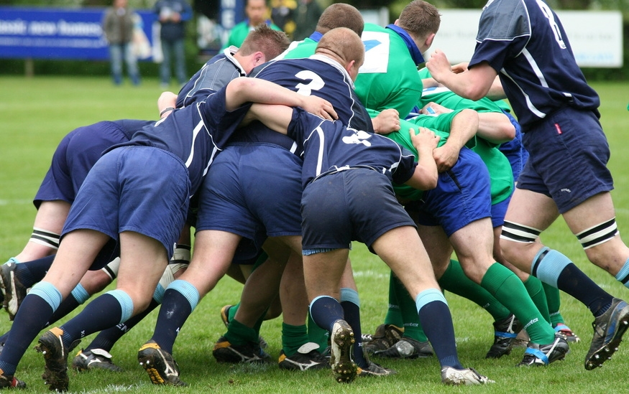
Teaching Games for Understanding (TGfU) ~ Tactical Games Model (TGM)
Problem-based approach to games teaching.
1980’s - Thorpe and Bunker developed TGfU; based on modified game play that set up tactical problems for students to solve.
Goal of TGM - improve students’ game performance by combining tactical awareness with skill execution and increase students’ interest and excitement about games.
Games Classification System
Game-Practice-Game format

Slide 13
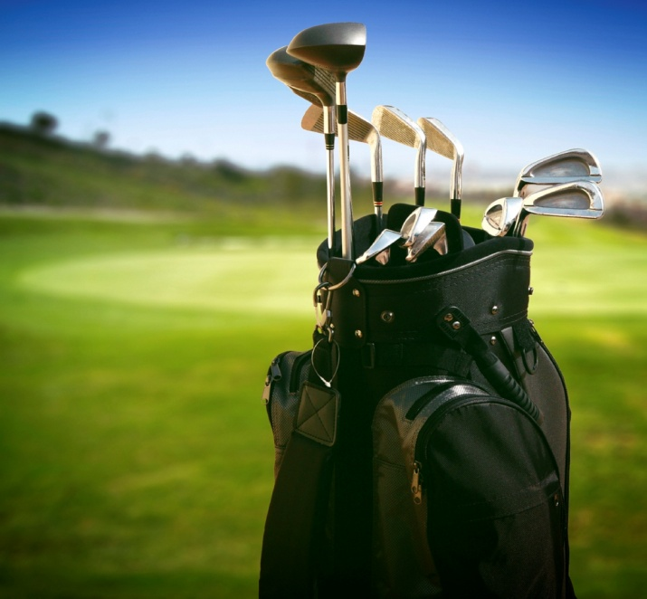
Sport Education Model (SEM)
Developed by Daryl Siedentop in 1984.
Purpose - create an authentic sport experience and educate and develop students to be competent, literate, and enthusiastic sportspersons.
The main features of the model include: seasons, team affiliation, formal competition, record keeping, culminating event, and festivity.

Slide 14
Fitness Education
Can include units on the health-related components of fitness, walking or hiking, or weight training.
Concepts-based Fitness and Wellness Model
Students engage in classroom discussions, laboratory activities, and physical activity experiences.
Goal - for students to learn how to develop and execute their own physical activity programs that they can participate in and out of school.

Slide 15
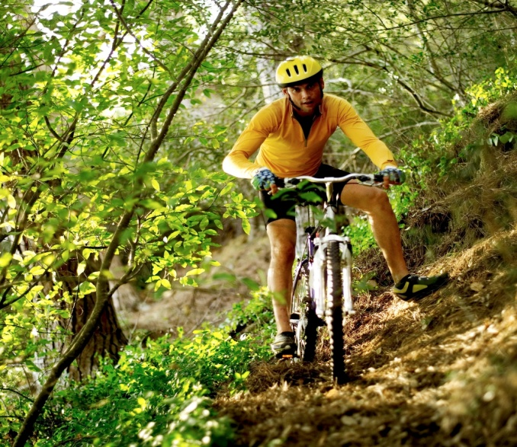
Adventure Education
3 Essential Practices:
Experiential Learning Cycle
Full Value Contract
Challenge by Choice
Allows students to learn about themselves and their peers as they take on individual and group tasks and challenges.
Teachers act as facilitators as students collaborate and problem-solve with one another to accomplish a task.
Project Adventure - based on 5 philosophical concepts, which include: challenge, cooperation, risk, trust, and problem-solving.

Slide 16
Outdoor Education
What activities come to mind when you think of outdoor education?
Occurs in the natural setting, where teachers and students have little to no control over the environment and potential hazards that may arise.
Emphasis placed on skill development.
Cost can be a factor for equipment.

Slide 17
Cultural Studies Curriculum in Physical Activity and Sport
Emphasizes students’ development as “literate and critical consumers of sport, physical activity, and the movement culture.”
Goal - for students to be able to observe, analyze, and critique physical activity and sport issues and topics in a variety of contexts.
Learning experiences occur both in the classroom and the gymnasium.
Mostly implemented in New Zealand, Australia, England.

Slide 19
Assessment and Accountability
Salient component needed to measure whether students have learned and are achieving the national standards.
Holds physical education programs and teachers accountable for student achievement.
Instructional Alignment - connecting the standards, instruction, and assessment components of physical education curricular and units of instruction.

Slide 21
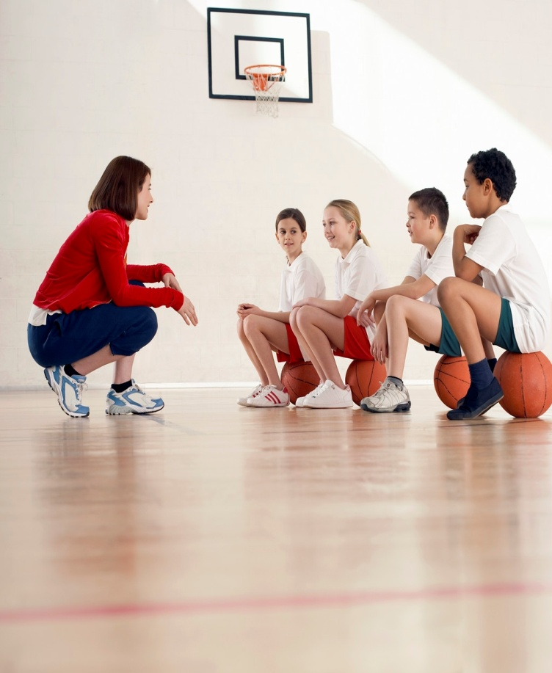
Characteristics of Effective Teaching
Use a variety of pedagogical skills and strategies to:
Ensure that their students are appropriately engaged in relevant activities a high percentage of the time
Hold positive expectations for their students
Create and maintain a classroom climate that is warm and nurturing.
Salient teacher behaviors can be divided into several broad areas: organization, communication, instruction, motivation, and human relations.

